Slide 1
Simplification of Context Free Grammars

Slide 2
Simplification of CFGs
Substitution Rule
Removing λ-productions
Removing Unit Productions/Chain rules
Removing Useless symbols
Augmented a Grammar
Removing Left Recursion
Left Factoring

Slide 3
A Substitution Rule
Equivalent
grammar
Substitute

Slide 4
Substitute
Equivalent
grammar

Slide 5
In general:
Substitute
equivalent
grammar

Slide 6
Context Free Grammars Killing λ-Productions

Slide 7
Killing λ-Productions
λ-Productions are undesirable.
In a given CFG, we call a non-terminal N nullable
if there is a production N → λ, or
there is a derivation that starts at N and lead to a λ.
N → ……… → λ
We can replace λ-production with appropriate non-λ productions.

Slide 8
Theorem 23
If L is CFL generated by a CFG having λ-productions, then there is a different CFG that has no λ-production and still generates either the whole language L (if L does not include λ) or else generate the language of all the words in L other than λ.
Proof by Construction (Replacement Rule):
Workout the Nullable Non-terminal
Delete all λ-Productions.
Add the following productions:
For every production of the X → old string Add new production of the form X → .., where right side will
account for every modification of the old string that can be formed by deleting all possible subsets of nullable non-Terminals, except that we do not allow X → λ, to be formed if all the character in old string are nullable

Slide 9
Delete all the Null productions and add new productions e.g.
consider the productions of a certain CFG X → aNbNa, N → λ, delete the production N → λ and using the
production X → aNbNa, add the new productions X → aNba, X → abNa and X → aba
Thus the new CFG will contain the productions
X → aNba | abNa | aba | aNbNa
Note: It is to be noted that X → aNbNa will still be included in the new CFG.

Slide 10
Nullable Variables
Nullable Variable:
Example:
Nullable variable

Slide 11
Removing
Substitute
After we remove all the
all the nullable variables disappear
(except for the start variable)

Slide 12
Example
Consider the CFG
S → a | Xb | aYa
X → Y | λ
Y → b | X
X and Y are nullable
X as X → λ
Y as Y → X →λ
So the new CFG is
S → a | Xb | aa | aYa |b
X → Y
Y → b | X

Slide 13
Example
Consider the CFG
S → Xa
X → aX | bX | λ
So the new CFG is
S → a | Xa
X → aX | bX | a | b

Slide 14
Example
S → XY
X → Zb
Y → bW
Z → AB
W → Z
A → aA | bA | λ
B → Ba | Bb | λ
Null-able Non-terminals are?
A, B, Z and W

Slide 15
Example Contd.
S → XY
X → Zb
Y → bW
Z → AB
W → Z
A → aA | bA | λ
B → Ba | Bb | λ
A, B, Z and W are nullable
So the new CFG is
S → XY
X → Zb | b
Y → bW | b
Z → AB | A | B
W → Z
A → aA | bA | a | b
B → Ba | Bb | a | b

Slide 16
Context Free Grammars Killing Unit Productions

Slide 17
Killing unit-productions
Definition: A production of the form
Nonterminal → one Nonterminal
is called a unit production.
The following theorem allows us to get rid of unit productions:
Theorem 24:
If there is a CFG for the language L that has no
λ-productions, then there is also a CFG for L with
no λ-productions and no unit productions.

Slide 18
Proof of Theorem 24
This is another proof by constructive algorithm
Algorithm: For every pair of nonterminals A and B, if the CFG has a unit production A → B, or if there is a chain
A ➔ X₁ ➔ X₂ ➔ … ➔ B
where X₁, X₂, ... are nonterminals, create new productions
as follows:
If the non-unit productions from B are
B → s₁ | s₂| …
where s₁, s₂, ... are strings, we create the productions
A → s₁| s₂| …

Slide 19
Example
Consider the CFG
S → A| bb
A → B | b
B → S | a
The non-unit productions are
S → bb A → b B → a
And unit productions are
S → A
A → B
B → S

Slide 20
Example contd.
Let’s list all unit productions and their sequences and create new productions:
S → A gives S → b
S → A → B gives S → a
A → B gives A → a
A → B → S gives A → bb
B → S gives B → bb
B → S → A gives B → b
Eliminating all unit productions, the new CFG is
S → bb | b | a
A → b | a | bb
B → a | bb | b
This CFG generates a finite language since there are no nonterminals in any strings produced from S.
S → A| bb
A → B | b
B → S | a

Slide 21
Unit-Productions
Unit Production:
(a single variable in both sides)
Example:
Unit Productions

Slide 22
Removal of unit productions:
Substitute

Slide 23
Unit productions of form
can be removed immediately
Remove

Slide 24
Substitute

Slide 25
Remove repeated productions
Final grammar

Slide 26
Useless Symbols
For a variable to be useful two conditions must be satisfied.
The variable must occur in a sentential form of the grammar
There must be a derivation of a terminal string from the variable.
A variable that occurs in a sentential form is said to be reachable from S.
A two part procedure is presented to eliminate useless symbols.

Slide 27
Algorithm to remove useless symbols
PART-I (from bottom to upward)
Identify variables that derive terminal strings
Remove non-terminals that do not derive terminal strings.
e.g. following grammar G = S → aS | A | C
A → a
B → aa
C → CB

Slide 28
Example
S → aS | A | C
A → a
B → aa
C → CB
We can identify variables that derive terminal strings.
i.e. A → a B → aa
And S ➔A ➔ a TERM = {S, A, B}
But C does not derive terminal, thus C is useless

Slide 29
Example
PART – II (from Top down)
Rename the grammar
GT = S → aS | A
A → a
B → aa
Now draw a graph and delete nodes not reachable from S.
As B is unreachable so delete it and the final grammar will be G_{V}= S→aS | A
A → a
aa
a
S
A
B

Slide 30
Useless Productions
Useless Production
Some derivations never terminate...

Slide 31
Another grammar:
Useless Production
Not reachable from S

Slide 32
In general:
contains only
terminals
if
then variable is useful
otherwise, variable is useless

Slide 33
A production is useless
if any of its variables is useless
Productions
Variables
useless
useless
useless
useless
useless
useless
useless

Slide 34
Removing Useless Productions
Example Grammar:

Slide 35
First:
find all variables that can produce
strings with only terminals
Round 1:
Round 2:

Slide 36
Keep only the variables
that produce terminal symbols:
(the rest variables are useless)
Remove useless productions

Slide 37
Second:
Find all variables
reachable from
Use a Dependency Graph
not
reachable

Slide 38
Keep only the variables
reachable from S
(the rest variables are useless)
Final Grammar
Remove useless productions

Slide 39
Example
Consider following CFG
G: S → AC | BS | B
A → aA | aF
B → CF | b
C →cC | D
D →aD | BD | C
E → aA | BSA
F → bB | b
A Two stage procedure

Slide 40
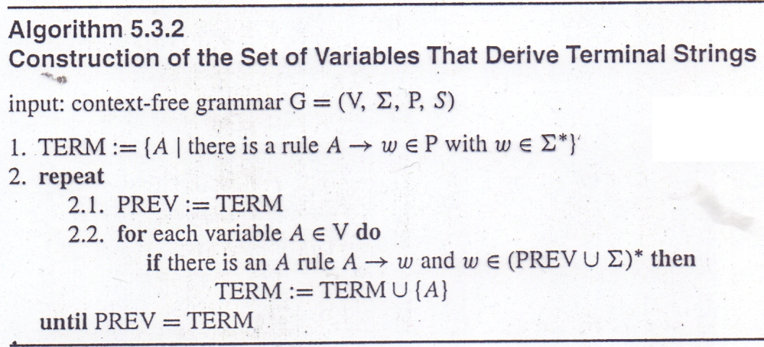

Slide 41
Satge-1 :
Construction of the set of Variables that derive terminal string
New Grammar from
TERM will be
G_{T}:
S →BS | B
A → aA | aF
B → b
E → aA | BSA
F → bB | b
S → AC | BS | B
A → aA | aF
B → CF | b
C →cC | D
D →aD | BD | C
E → aA | BSA
F → bB | b
Iteration
TERM
PREV
0
{B, F}
{ }
1
{B, F, A, S}
{B, F}
2
{B, F, A, S, E}
{B, F, A, S}
3
{B, F, A, S, E}
{B, F, A, S, E}

Slide 42
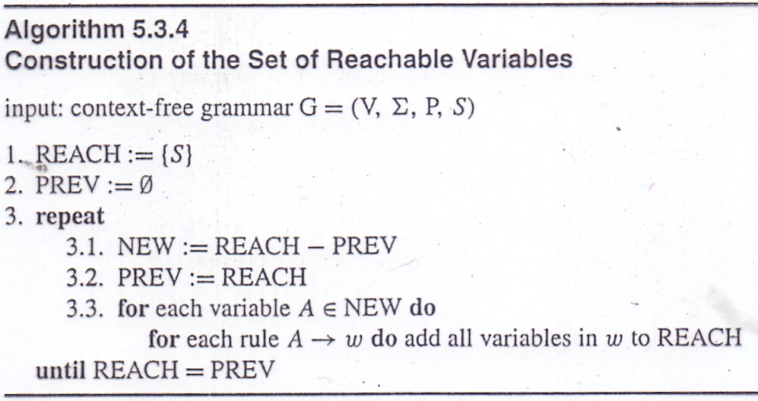

Slide 43
Construction of the set of Reachable Variables
Original Grammar
S → AC | BS | B
A → aA | aF
B → CF | b
C →cC | D
D →aD | BD | C
E → aA | BSA
F → bB | b
New Grammar from
TERM will be
G_{T}:
S →BS | B
A → aA | aF
B → b
E → aA | BSA
F → bB | b
Final Grammar will be
G_{F}:
S →BS | B
B → b
Iteration
REACH
PREV
NEW
ᶲ
0
{S}
{ }
1
{S, B}
{S}
{S}
2
{S, B}
{S, B}
{B}

Slide 44
Removing All
Step 0: Adding a new start symbol by S₀ → S if the original start symbol ‘S’ is recursive.
Step 1: Remove Nullable Variables
Step 2: Remove Unit-Productions
Step 3: Remove Useless Variables

